Slide 1

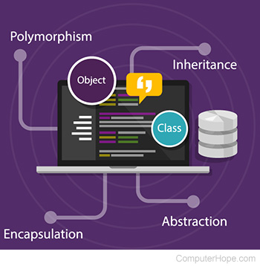
Object Oriented Programming
Abstract class
Class Presentations on Object Oriented Programming
by Subhash Chand Agrawal

Slide 2

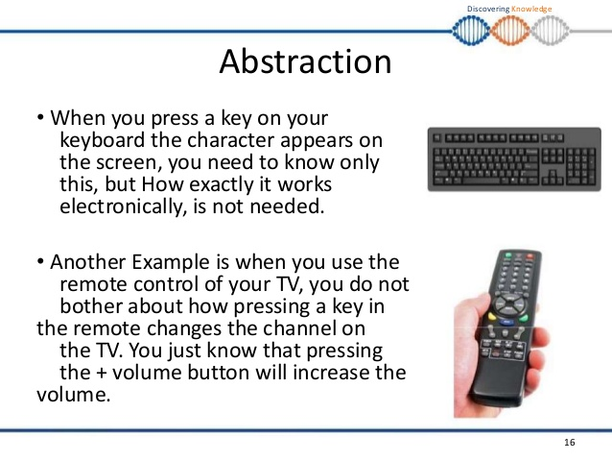

What is abstraction?
Abstraction is a process of hiding the implementation details and showing only functionality to the user.

Slide 3
Ways to achieve Abstraction
There are two ways to achieve abstraction in java
  Abstract class (0 to 100%)
  Interface (100%)

Slide 4
Abstract class in Java
A class which is declared with the abstract keyword is known as an abstract class in Java.
It can have abstract and non-abstract methods (method with the body).
It needs to be extended and its method implemented.
It cannot be instantiated.
Notes:
1)

Slide 5
Abstract class in Java
An abstract class must be declared with an abstract keyword.
It can have abstract and non-abstract methods.
It cannot be instantiated.
It can have constructors and static methods also.
It can have final methods which will force the subclass not to change the body of the method.

Slide 6
Examples
Example of abstract class
abstract class A{}
Abstract Method in Java
A method which is declared as abstract and does not have implementation is known as an abstract method.
Example of abstract method
abstract void printStatus();

Slide 7
abstract class vehicle{
abstract void speed();
}
public class car extends vehicle{
void speed()
{
System.out.println("Drive safely");
}
public static void main(String args[]){
vehicle obj = new car();
obj.speed();
}
}

Slide 8
Examples
Write a java program to create an abstract class named Shape that contains two integers and an abstract method named printArea(). Provide three classes named Rectangle, Triangle and Circle such that each one of the classes extends the class Shape. Each one of the classes contain only the method printArea( ) that prints the area of the given shape.

Slide 9
abstract class shape
{
int a=3,b=4;
abstract public void print_area();
}
class rectangle extends shape
{
public int area_rect;
public void print_area()
{
area_rect=a*b;
System.out.println("The area of rectangle is:"+area_rect);
}
}

Slide 10
class triangle extends shape
{
int area_tri;
public void print_area()
{
area_tri=(int) (0.5*a*b);
System.out.println("The area of triangle is:"+area_tri);
}
}
class circle extends shape
{
int area_circle;
public void print_area()
{
area_circle=(int) (3.14*a*a);
System.out.println("The area of circle is:"+area_circle);
}
}

Slide 11
public class JavaApplication3 {
public static void main(String[] args) {
shape r=new rectangle();
r.print_area();
shape t=new triangle();
t.print_area();
shape r1=new circle();
r1.print_area();
}
}

Slide 12
Abstract class having constructor, data member and methods

Slide 13
abstract class Maruti{
Maruti(){System.out.println("Maruti car is created");}
abstract void drive();
void changeGear(){System.out.println("gear changed");}
}
class car extends Maruti{
void drive(){System.out.println("driving safely..");}
}
public class Test{
public static void main(String args[]){
Maruti obj = new car();
obj.drive();
obj.changeGear();
}
}
Maruti car is created
driving safely..
gear changed

Slide 14
abstract class Maruti{
Maruti(){System.out.println("Maruti car is created");}
abstract void drive();
void changeGear(){System.out.println("gear changed");}
}
class car extends Maruti{
void drive(){System.out.println("driving safely..");}
}
public class Test{
public static void main(String args[]){
car obj = new car();
obj.drive();
obj.changeGear();
}
}
Maruti car is created
driving safely..
gear changed

Slide 15
abstract class Maruti{
Maruti(){System.out.println("Maruti car is created");}
abstract void drive();
void changeGear(){System.out.println("gear changed");}
}
class car {
void drive(){System.out.println("driving safely..");}
}
public class Test{
public static void main(String args[]){
Maruti obj = new car();
obj.drive();
obj.changeGear();
}
}
Test.java:12: error: incompatible types: car cannot be converted to Maruti Maruti obj = new car(); ^1 error

Slide 16
abstract class Maruti{
Maruti(){System.out.println("Maruti car is created");}
abstract void drive();
void changeGear(){System.out.println("gear changed");}
}
class car {
void drive(){System.out.println("driving safely..");}
}
public class Test{
public static void main(String args[]){
car obj = new car();
obj.drive();
obj.changeGear();
}
}
/Test.java:15: error: cannot find symbol obj.changeGear(); ^ symbol: method changeGear() location: variable obj of type car1 error

Slide 17
Q1
Which of these is not a correct statement?
a) Every class containing abstract method must be declared abstract
b) Abstract class defines only the structure of the class not its implementation
c) Abstract class can be initiated by new operator
d) Abstract class can be inherited
Ans: c

